Slide 1


Data Preprocessing
cleaning the data to handle missing values, removing outliers, scaling features, encoding categorical variables, and splitting the data into training and testing sets.

Slide 2

Introduction to Data Preprocessing
Data preprocessing is a set of techniques applied to raw data to prepare it for analysis by machine learning algorithms.
This stage is crucial to ensure that data is clean, consistent, and suitable for model training.
Machine Learning

Slide 3
Why is Data Preprocessing Important?
Improves Model Accuracy: Models trained on well-preprocessed data tend to make more accurate predictions because they are free from inconsistencies and errors.
Ensures Consistency: Raw data often has missing values, duplicates, or noise. Preprocessing standardizes the data, making it consistent across different sources and formats.
Speeds Up Model Convergence: Proper scaling and normalization reduce computational requirements, helping models converge faster and optimizing training time.
Enhances Generalization: Preprocessing minimizes biases and improves the model’s ability to generalize well on new data, reducing the risk of overfitting.
Machine Learning

Slide 4
Key Steps in Data Preprocessing:
Data Cleaning: Identifying and fixing or removing errors, handling missing values, and dealing with duplicates and outliers.
Data Transformation: Converting data types, encoding categorical data, and scaling or normalizing features to bring them to a comparable range.
Feature Selection and Engineering: Selecting only the most relevant features, removing redundancies, and creating new features that add predictive power.
Data Splitting: Dividing data into training, validation, and test sets to evaluate model performance on unseen data and tune parameters.
Machine Learning

Slide 5
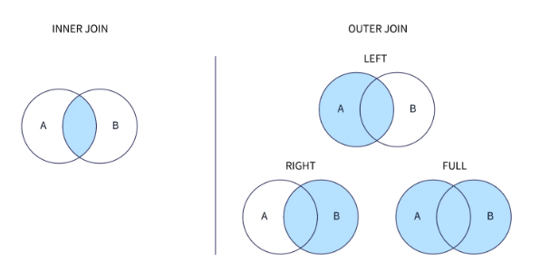
Merge Datasets
Machine Learning

Slide 6
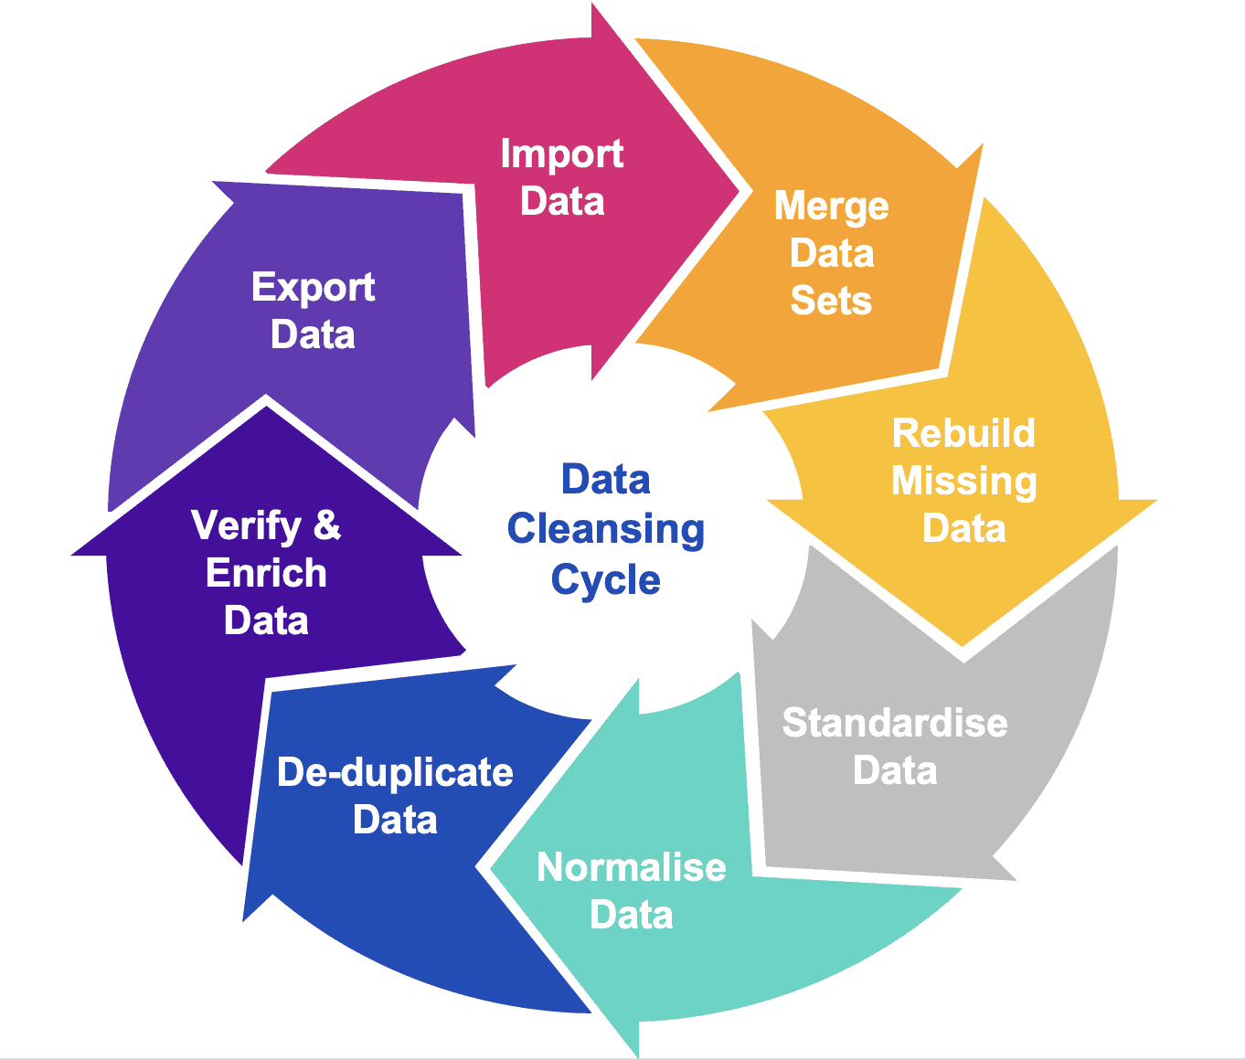
1) Data Cleaning
Data cleaning, also referred to as data Cleansing , is the process of fixing incorrect, incomplete, duplicate or otherwise erroneous data in a data set.
It involves identifying data errors and then changing, updating or removing data to correct them.
Machine Learning

Slide 7
1) Data Cleaning
Data
Handling Missing Data
Imputation
Remove
Imputation or the removal of data.
The imputation method develops reasonable guesses for missing data.
It's most useful when the percentage of missing data is low.
Delete Rows/Columns: Simple but may reduce data size significantly.
Impute Values: Replace with mean, median, or mode.
Machine Learning

Slide 8
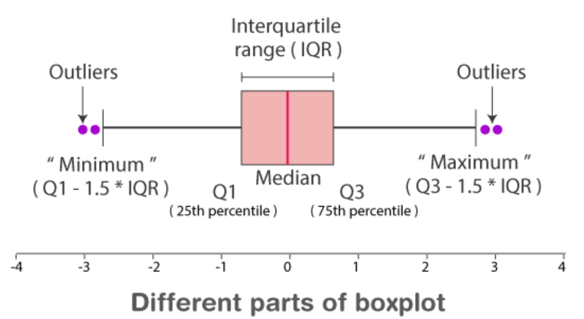
1) Data Cleaning
Dealing with Outliers
Detecting and handling outliers is essential to improve the performance of machine learning models and ensure accurate data analysis.
Machine Learning

Slide 9
1) Data Cleaning
Dealing with Outliers
Removing Outliers: When you have enough data, removing extreme outliers can help. However, this is not advisable if the outliers carry important information (e.g., fraud detection).
Transforming Data: Logarithmic or square root transformations can reduce the impact of large outliers by compressing their scale.
Capping: Set a threshold and cap all values above or below this threshold. For example, values above the 99th percentile can be set to the 99th percentile value.
Imputation: Replace outliers with a representative value, such as the mean or median, which can reduce their impact.
Using Robust Models: Algorithms like decision trees and random forests are less sensitive to outliers. Robust models can reduce the need for preprocessing steps.
Machine Learning

Slide 10
1) Data Cleaning
Dealing with Outliers
Removing Outliers: When you have enough data, removing extreme outliers can help. However, this is not advisable if the outliers carry important information (e.g., fraud detection).
Transforming Data: Logarithmic or square root transformations can reduce the impact of large outliers by compressing their scale.
Capping: Set a threshold and cap all values above or below this threshold. For example, values above the 99th percentile can be set to the 99th percentile value.
Imputation: Replace outliers with a representative value, such as the mean or median, which can reduce their impact.
Using Robust Models: Algorithms like decision trees and random forests are less sensitive to outliers. Robust models can reduce the need for preprocessing steps.
Choosing the right method depends on the
Dataset.
The significance of the outliers.
The overall objective of the analysis or model.
Machine Learning

Slide 11
2) Data Transformation
Encoding Categorical Variables
Convert categorical data into numerical form for the model to understand.
Types of Encoding:
Label Encoding: Assigns numbers to categories; useful for ordinal data.
One-Hot Encoding: Creates binary columns for each category; ideal for non-ordinal data.
Machine Learning

Slide 12
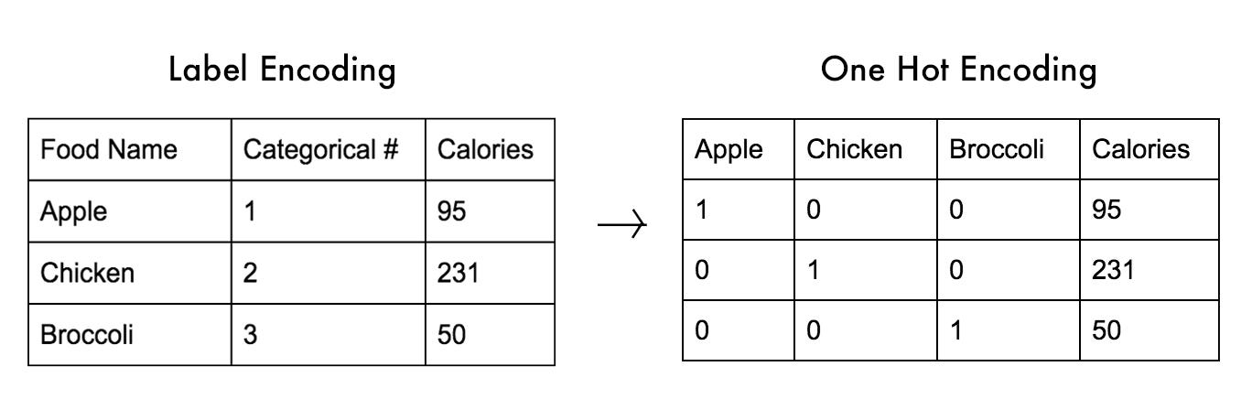
2) Data Transformation
Encoding Categorical Variables
Types of Encoding:
Convert categorical data into numerical form for the model to understand.
Label Encoding: Assigns numbers to categories; useful for ordinal data.
One-Hot Encoding: Creates binary columns for each category; ideal for non-ordinal data.
Machine Learning

Slide 13
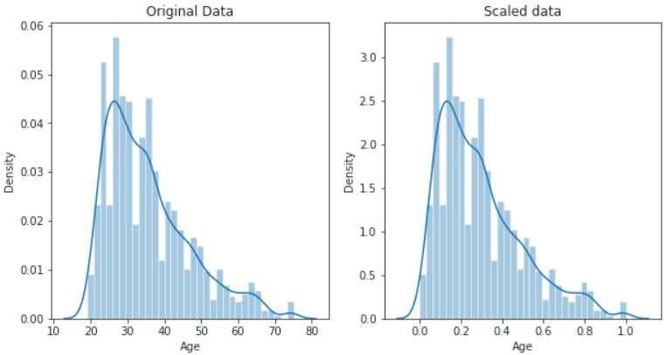
2) Data Transformation
Feature Scaling
transforming features so that they are on a similar scale, which helps improve model performance, especially for algorithms sensitive to the magnitude of data, like distance-based and gradient-based models.
Types of Scaling:
Normalization
Standardization
Machine Learning

Slide 14
2) Data Transformation
Feature Scaling
Normalization
Range: Scales data to a range of [0, 1] or [-1, 1].
Sensitive to Outliers: Normalization can be significantly affected by the presence of outliers since it depends on the minimum and maximum values.
Min-Max Normalization
  Scales each feature to a specified range, typically [0, 1].
  Use Case: Commonly used in neural networks and deep learning, where inputs need to be within a standard range.
Machine Learning

Slide 15
2) Data Transformation
Feature Scaling
Standardization
Range: Scales data to have a mean of 0 and a standard deviation of 1.
Robust to Outliers: Less affected by outliers than normalization because it uses the mean and standard deviation.
Z-score Normalization (Standardization)
  Standardizes features to have a mean of 0 and a standard deviation of 1, effectively rescaling data to a "standard normal distribution.“
  Use Case: Often used when data is approximately normally distributed, for models sensitive to feature scales (e.g., linear regression, SVM, kNN).
Machine Learning

Slide 16
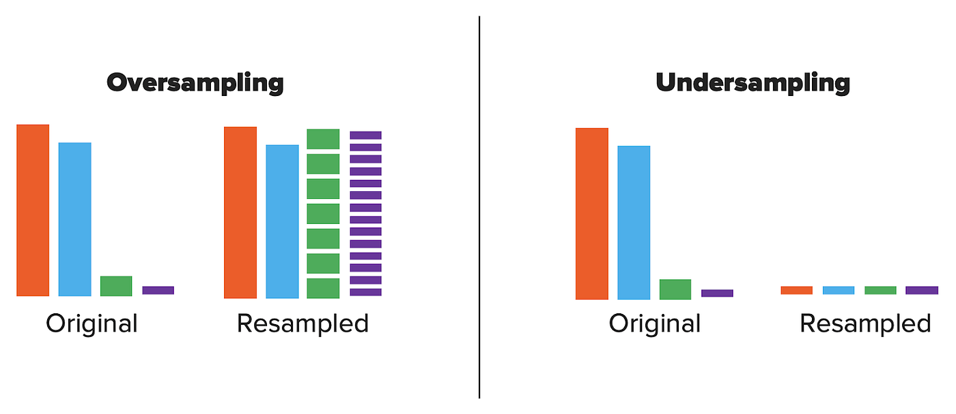
3) Handle Imbalanced Data
Majority to the central of a society, while minority becomes marginalized.
Machine Learning

Slide 17
3) Handle Imbalanced Data
Oversampling
increasing the number of instances in the minority class to balance the class distribution.
Random Oversampling
SMOTE
Randomly duplicate instances from the minority class until the classes are balanced.
Generates synthetic examples by interpolating between existing minority class examples.
  Pros: Simple and easy to implement.
  Cons: Can lead to overfitting because it duplicates exact copies of minority class instances.
  Pros: Reduces the risk of overfitting compared to random oversampling.
  Cons: Can create overlapping between classes, leading to increased noise.
Machine Learning

Slide 18
3) Handle Imbalanced Data
Undersampling
reducing the number of instances in the majority class to balance the class distribution.
Random Undersampling
Cluster-Based Undersampling
Randomly remove instances from the majority class until the classes are balanced.
Clusters the majority class instances and then selects representative samples from each cluster.
  Pros: Simple and easy to implement; reduces dataset size, making computations faster.
  Cons: Can lead to loss of valuable information and potentially underfitting if important instances are removed.
  Pros: Preserves important information by retaining diverse examples from the majority class.
  Cons: More complex to implement and may require tuning of clustering parameters.
Machine Learning

Slide 19
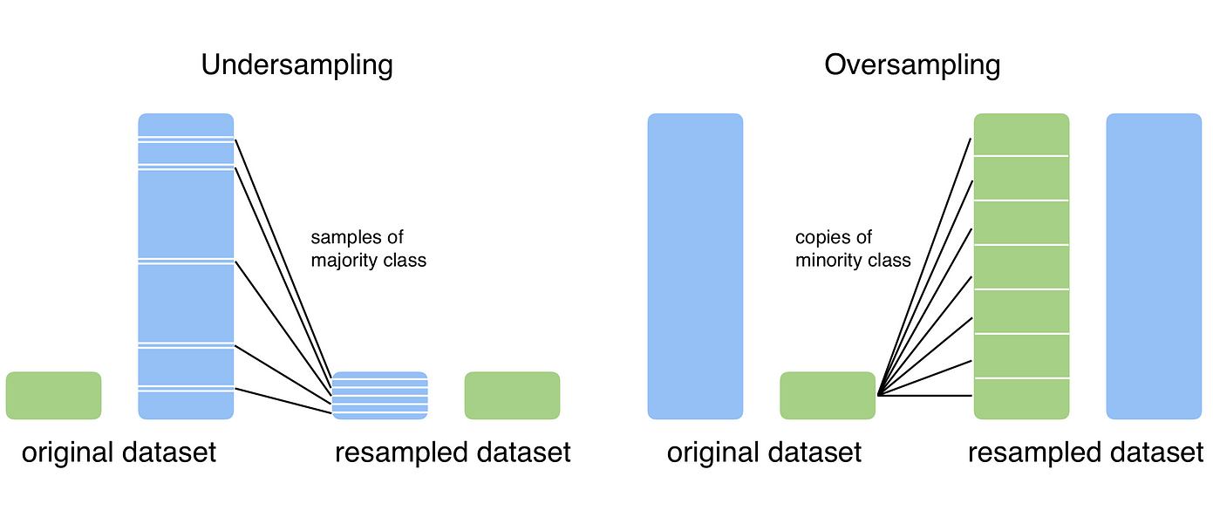
3) Handle Imbalanced Data
When to use Oversampling & Undersampling?
The choice between oversampling and undersampling depends on various factors, including
The size of the dataset.
The degree of imbalance.
The specific machine learning algorithm used.
Machine Learning

Slide 20
3) Handle Imbalanced Data
When to use Oversampling & Undersampling?
When to Use Oversampling?
When to Use Undersampling
Small Datasets: When the dataset is small, undersampling could lead to a significant loss of information. Oversampling helps retain all available data.
Avoiding Information Loss: Oversampling is preferable when it is critical to retain as much information as possible from the original dataset.
Avoiding Underfitting: When the risk of underfitting is high, oversampling can be beneficial as it ensures that the model has enough examples to learn from the minority class.
Large Datasets: When the dataset is large, undersampling can reduce computational cost and speed up training without significant loss of information.
Highly Imbalanced Datasets: When the class imbalance is extreme, oversampling might lead to very large datasets, making undersampling a more practical solution.
Avoiding Overfitting: When the risk of overfitting is high, especially with models prone to overfitting, such as decision trees, undersampling can help by simplifying the dataset.
Machine Learning

Slide 21
4) Feature Selection
Reduces dimensionality and focuses on the most relevant features.
Methods:
Correlation Analysis: Remove highly correlated features.
Tree-Based Models: Use feature importance scores.
Statistical Tests: ANOVA, Chi-Square test for feature significance.
Machine Learning

Slide 22
5) Data Splitting
Prevents overfitting and ensures model performance on unseen data.
Approach:
Training Set: Used to train the model.
Validation Set: Tunes model parameters.
Test Set: Evaluates final model performance.
Machine Learning

Slide 23
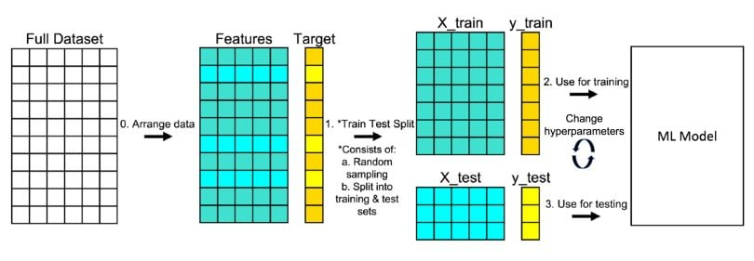
5) Data Splitting
Prevents overfitting and ensures model performance on unseen data.
Machine Learning

Slide 24
THANK YOU!
Any Question!
The End

